Slide 1
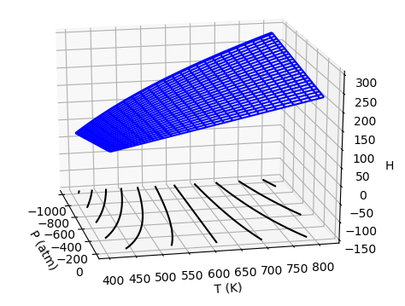


Week 7 – $H(T,P)$as a thermodynamic surface
$${\left(\frac{∂H}{∂T}\right)}_{P}$$
$${\left(\frac{∂H}{∂P}\right)}_{T}$$
Pressure
Temperature
$$dH=C_{P}dT+μ_{T}dP$$

Slide 2
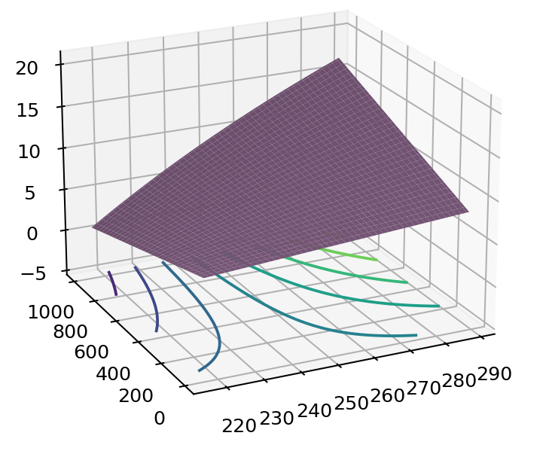


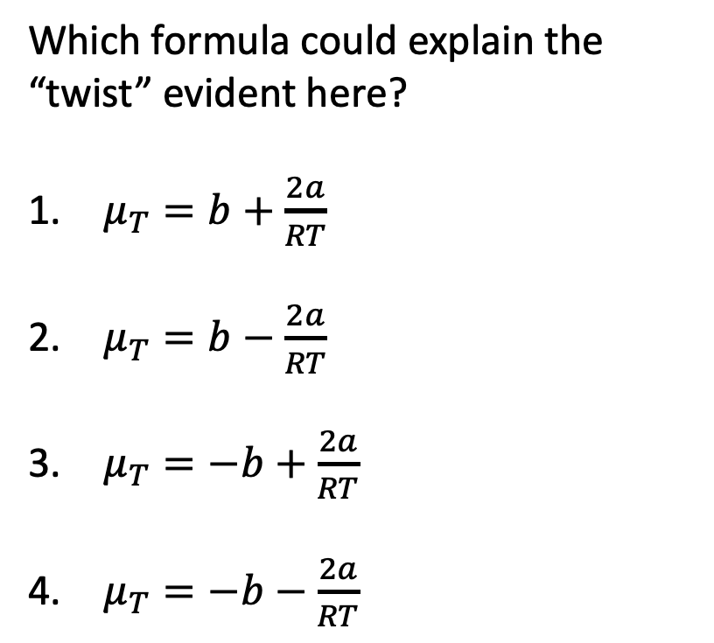
The kind of question I might ask – The twist in $H\left(T,P\right)$
$$H$$
Which formula could explain the “twist” evident here?
$μ_{T}=b+\frac{2a}{RT}$
$μ_{T}=b−\frac{2a}{RT}$
$μ_{T}=−b+\frac{2a}{RT}$
$μ_{T}=−b−\frac{2a}{RT}$
P
T
$$dH=C_{P}dT+μ_{T}dP$$

Slide 3
The kind of question I might ask – Contours of $H\left(T,P\right)$
$$H$$
The contours are called
Isentropes
Isochores
Isobars
Isenthalps
Isotherms
P
T

Slide 4
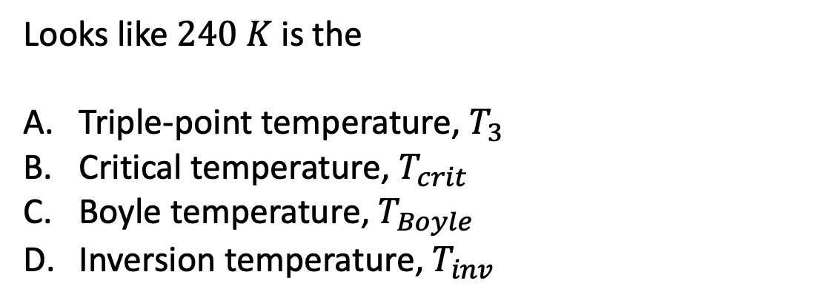
The kind of question I might ask – Characteristic temperatures of gases
$$H$$
Looks like $240 K$ is the
Triple-point temperature, $T_{3}$
Critical temperature, $T_{crit}$
Boyle temperature, $T_{Boyle}$
Inversion temperature, $T_{inv}$
H
P
T

Slide 5
The kind of question I might ask – Characteristic temperatures of gases
$$H$$
Looks like $240 K$ is the
Triple-point temperature, $T_{3}$
Critical temperature, $T_{crit}$
Boyle temperature, $T_{Boyle}$
Inversion temperature, $T_{inv}$
H
P
T

Slide 6
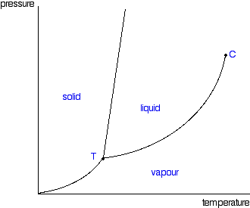
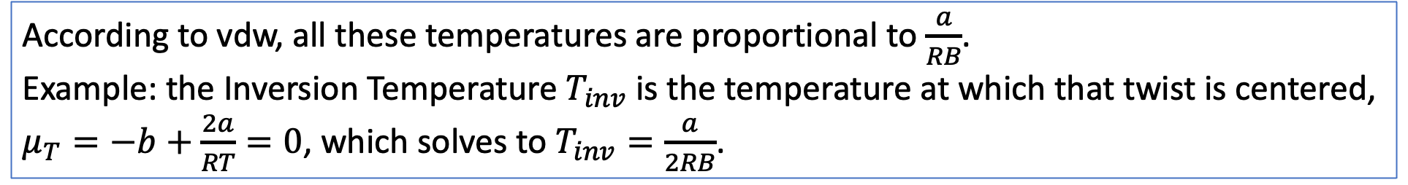





Week 9 – How the characteristic temperatures line up in a phase diagram
$$∆H_{vap}$$
$$∆V_{vap}$$
$$T_{3}$$
$$T_{crit}$$
$$T_{Boyle}$$
$$T_{inv}$$
According to vdw, all these temperatures are proportional to $\frac{a}{RB}$.
Example: the Inversion Temperature $T_{inv}$ is the temperature at which that twist is centered, $μ_{T}=−b+\frac{2a}{RT}=0$, which solves to $T_{inv}=\frac{a}{2RB}$.

Slide 7
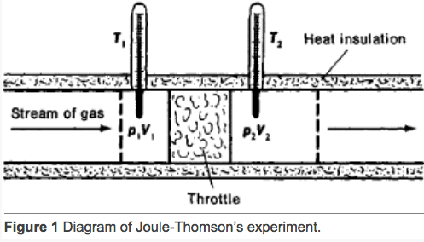
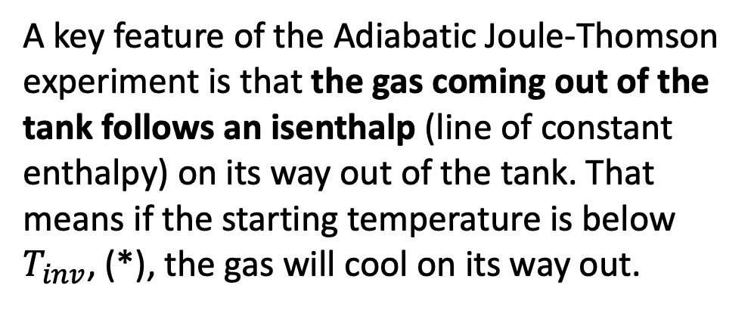
Week 8 – The Adiabatic Joule-Thomson experiment
$$H$$
H
*
A key feature of the Adiabatic Joule-Thomson experiment is that the gas coming out of the tank follows an isenthalp (line of constant enthalpy) on its way out of the tank. That means if the starting temperature is below $T_{inv}$, (*), the gas will cool on its way out.
P
T

Slide 8
The kind of question I might ask – Relating the experiment to theory
$$H$$
H
*
We used the temperature of the gas coming out of the tank to calculate $∆T/∆P$, which we equated to
${\left(\frac{∂T}{∂P}\right)}_{H}$
${\left(\frac{∂H}{∂T}\right)}_{P}$
${\left(\frac{∂H}{∂P}\right)}_{T}$
P
T

Slide 9
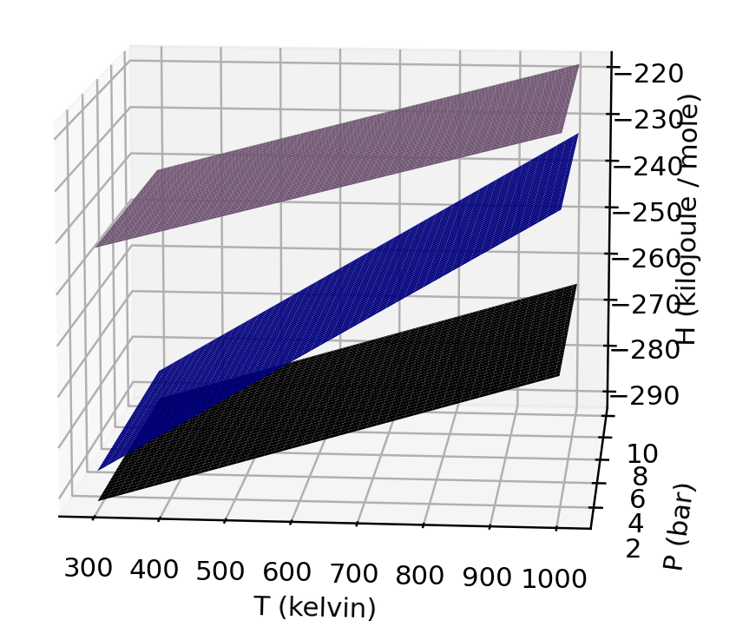
Week 8 – $ΔH_{rxn}$ and $Δ(ΔH_{rxn})$
We designated $ΔH_{rxn}^{o}$ as the value of ${ΔH}_{rxn}$at some “standard state,” as a reference point.
Then we designated $Δ(ΔH_{rxn})$ as the change relative to that standard state.
This was all summed up in the formula
$$ΔH_{rxn}=ΔH_{rxn}^{o}+Δ(ΔH_{rxn})$$
gas
liquid
$$ΔH_{vap}$$
$$ΔH_{vap}^{o}$$
solid

Slide 10
The kind of question I might ask – Physical properties governing $ΔH_{rxn}$ and $Δ(ΔH_{rxn})$
The physical property of the liquid and vapor responsible for the reduction in $ΔH_{rxn}$ at higher temperatures can be ascribed to their
Deviation from ideal behavior
Difference in entropies
Difference in heat capacities
Difference in Gibbs energies
gas
liquid
$$ΔH_{vap}$$
$$ΔH_{vap}^{o}$$
solid

